Slide 1
Final Project
Online Photo Design
Online Photo Design
6150 Web Design/User Experien Engr
final-project-cgfz

Slide 2
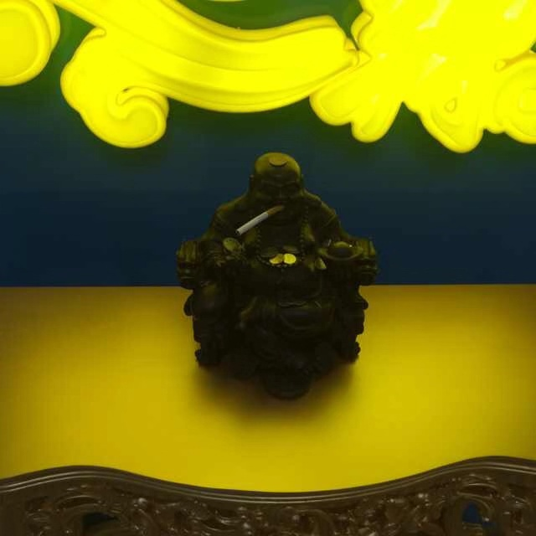




Team Members
Yumeng Chen
Handan Gu
Wenkai Zheng
Wenhao Feng
001409547
001448323
001444202
001449559

Slide 3
CATALOGUE
1
Project Topic
2
Approach
3
User Cases
4
Demo

Slide 4


Project Topic

Slide 5

Topic
Online image editor app
Based on social model nowadays, people like sending greeting messages to each other. But the message is too simple, we can provide a website to help them design their own greeting card with the photos they like. Then, they can send the cards to their friends by e-mail.

Slide 6

Approach

Slide 7
Online Photo Design
--Upload your photo or choose one from server
--Edit the Greeting Card
--Send to the Target E-mail Address

Slide 8




Approach
Online Free Picture Pool
Read from the database. Provide users with some choices to start the edit.
Upload Local Pictures
Users can upload their own picture to design a special card.
Edit Tools
Provide users tools to edit the design, such as resize, scale, add texts.
Share
Users can send the greeting card to a target e-mail address. They can also share their design with other users.

Slide 9

User cases

Slide 10
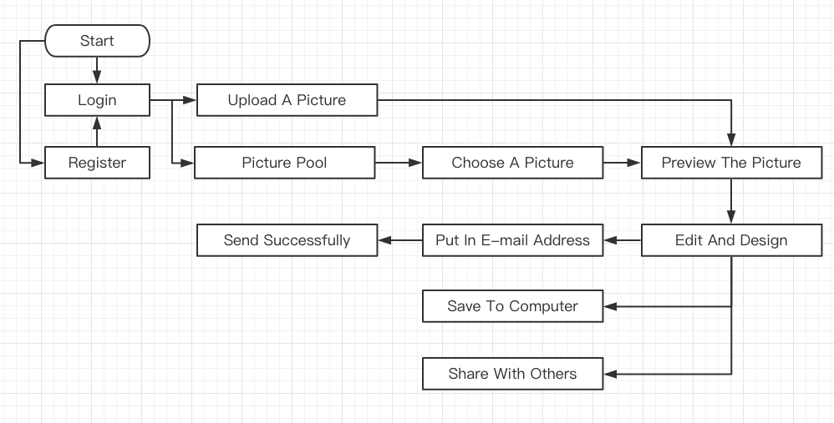
Work Flow

Slide 11
Spotlight 1
Sending E-mail
After inputting an e-mail address, they can send the greeting to their friend. No need to waste time opening their mail apps and designing cards by Photoshop. We also support anonymous email.

Slide 12
Spotlight 2
I-cloud Picture Store
We build our picture pool based on Alibaba Cloud. All the design from our users can saved to this cloud store pool. The website can read from the cloud to display the pictures, then users can choose one of these pictures to design their greeting cards.

Slide 13

Demo

